Slide 1
IBM SmartCloud Entry 概述
IBM Confidential

Slide 2
Agenda
Iaas & SmartCloud Entry
IBM Cloud Announcement & SmartCloud Entry
SmartCloud Entry architecture
Other cloud products
Q&A

Slide 3
Infrastructure as a Service
Infrastructure Includes
  Servers
  Storage
  Network
  Equipments
  Data Center
  Fabrics
  Virtualization
Collaboration
CRM/ERP/HR
Business
Processes
Industry
Applications
Software as a Service (SaaS)
Middleware
Web 2.0 Application
Runtime
Java
Runtime
Database
Development
Tooling
Platform as a Service (PaaS)
Servers
Networking
Data Center
Fabric
Storage
Shared, virtualized, dynamic provisioning
Infrastructure as a Service (IaaS)

Slide 4



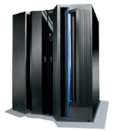

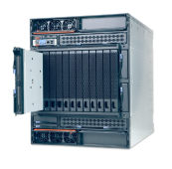


IaaS的基本架构
Web 2.0
Collaborative
Innovation
Software
Development
Virtual
Classroom
Data
Intensive
Processing
High Volume
Transactions
Workloads
Service
Catalog
Request
UI
Operations
UI
Dynamic Scheduling
Capacity Planning
SLA
Monitoring
Request Driven Provisioning & Service Management
Virtual
Servers
Virtual
Storage
Virtual
Networks
Virtualization
Non-IBM Servers
IBM System z
Power Systems
System x, BladeCenter
IBM & Other
Storage
Networking
Physical Layer

Slide 5
Cloud “as a Service” (IaaS, PaaS, SaaS)
IaaS is the foundation for higher level PaaS and SaaS solutions
Software
APP
APP
APP
APP
APP
APP
APP
Platform
Middleware
Middleware
Middleware
Infrastructure
IBM SmartCloud Entry
provides all essential IaaS capabilities
xLinux, Windows
AIX, pLinux
z/OS, zLinux
Virtual Servers, Storage, Network
Firmware and Hypervisors
Server, Storage, Network Resources

Slide 6










IBM SmartCloud Entry
Infrastructure as a Service + integrated IBM infrastructure
Transforms new and existing infrastructure to the cloud
Differentiating Capabilities
Why IBM?
Integration and Optimization:
Integrated, standardized cloud management software optimized for IBM Systems
Enterprise Class Integrity and Security:
Enterprise class security provided through System p and System x
Fault tolerant system infrastructure
Manage Velocity of Business Change:
Flexible, modular design with small footprint
Open, extensible platform via REST APIs for UI customization
Analytics:
Single pane of glass for analyzing and managing approvals, metering, billing, users, and projects
Improved Profitability
Price Advantage – fixed per server, not per VM – scale with less expense and greater value for higher VM densities
Accelerate Time to Market
Time to market - Demonstrated 35x improvement for deploying new applications
Implement private cloud on IBM hardware in 2-3 days
Breadth, Openness, and Ecosystem
Architecture supports multiple platforms enabling clients to use same self service provisioning portal to create workloads independent of platform
Hypervisor choice - future hypervisor transition allows clients to maintain value of investment
Notes:
If the client has virtualization installed, power VM / VMControl or VMWare / Vcenter then it takes less than an hour to install and the client can have the cloud configured and running in 2-3 days
The architecture supports multiple platforms - PowerVM on Power and VMware (and eventually Hyper-V and KVM) on System x. This is a unique differentiator that allow clients to use the same self-service provisioning Web portal to create workloads on either platform. Not possible in vCloud Director or any competing entry cloud product
Improved Profitability
Price Advantage – fixed per server – not per VM - so scale with less expense and has greater value for higher VM densities
Accelerate Time to Market
Time to market - Demonstrated 35x improvement for new applications
Implement private cloud on IBM hardware in 2-3 days
Breadth, Openness, and Ecosystem
Architecture supports multiple platforms enabling clients to use same self service provisioning portal to create workloads on either platform
Hypervisor choice - future hypervisor transition allows clients to maintain value of investment

Slide 7
IBM SmartCloud Entry Solution Architecture
SmartCloud Entry
Management Stack
Self-service UI
REST API
Cloud administration
and management
Tivoli Provisioning
Manager
for Images 7.1.1
VMC API
vCenter API
VMControl
VMware
vCenter
IBM Systems
Director
PowerVM
ESXi
IBM Systems
Director
Power HW
System x HW
Includes all SmartCloud Entry versions
Power only
X86 only

Slide 8
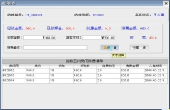


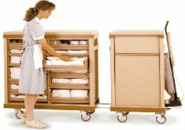


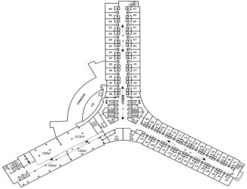
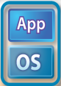
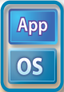






IBM SmartCloud Entry – cross platform IaaS
VMware
SmartCloud Entry
SI/ISV Applications
SI/ISV, Client Applications
vCloud
SmartCloud Entry
Cloud Management
vCenter
VMControl
IBM Systems Director
System Management
vSphere
PowerVM
KVM, VMware
zVM
Virtualization (Hypervisor)
x86
Power
System x
ELS
SmartCloud Entry与VMware的比较
  多平台 vs. 只有x86
  虚拟机和物理机同时管理 vs. 只能管理虚拟机
  开放的生态环境和IBM实验室支持 vs. 软件销售

Slide 9








IBM Systems Director VMControl
最新跨平台虚拟化管理利器
虚拟化的基础设施
系统池
(Cloud Ready)
虚拟化管理器
简化虚拟资源生命周期管理
实时监控虚拟资源的健康状况
跨平台虚拟化管理
系统池管理器
自动化业务部署
工作负载高可用及业务连续性
减少宕机时间
有助于构建云端计算环境
虚拟机映像
Image
Image
App
Image
App
Image
OS
App
OS
App
OS
OS
虚拟映像管理器
快速业务部署和调整能力，提升效率
简化工作负载部署，将用户从IT细节中解放出来
大大降低业务部署出错的可能性

Slide 10


CFS 基础架构云计算解决方案
IT基础架构管理可以变得更加轻松和高效：
自助式，按需获取计算资源, 快速部署操作系统和应用
标准化
标准化的资源管理流程
资源生命周期管理
基于角色的权限控制
资源使用计量与计费
按使用量付费
基于REST的开放接口
CFS
自动化
自助服务
更低的运维成本
按需计算
审计日志与报表
资源调度引擎
容错与高可用性
虚拟化
更高的资源利用率
更少的硬件投资
虚拟化资源池
动态的可扩展的资源调度
快速部署操作系统和应用
VMControl
Notes:
The economic factors driving cloud computing are not new technologies. Rather it is the combination of existing technologies with a focus on the end user and enabling the end user experience. Virtualization drives higher utilization which lowers capital expenses. Standardization also reduces capital and labor costs, while automation reduces management costs, drives an enhanced user experience and automates many manual tasks to reduce errors and reduce the costs associated with managing an environment.
You can have cloud without these elements, but it will not be a cost effective cloud that delivers with stability and an enhanced end user experience of self-enablement and self-management.

Slide 11

IBM SmartCloud Entry multiple Clouds support
SmartCloud Entry
Multiple SCE instances
Active-Active mode
VMControl
VMControl
Power/KVM
zManager/?
TPC/?
vCenter
KVM
VMControl
zVM
File/Object
Storage
HSLT
ESX/ESXi
Power
KVM/Xen/
Hyper-V
*All statements regarding IBM's future direction and intent are subject to change or withdrawal without notice, and represent goals and objectives only. Some features require the purchase of additional software components.

Slide 12

SmartCloud Entry Architecture Inside
Web GUI
REST API
SCE
SCE API
Billing
Account
Request
Metering
Metering
Resource dashboard
Monitoring
Derby
File
DB2
Deployments
Message Queue
Appliances
User
mgmt
Persistence
Services
Hosts
Users
Users
Metering
Audit logs
Configuration
Approval flow
Audit service
Metering records
Billing
Image mgmt
Deployment
Resource mgmt
VMControl Adapter
vCenter Adapter
HSLT Adapter
OSGi Runtime

Slide 13




CFS 云计算生态系统 – 完全开放的REST API, 模块化的可扩展的架构设计
BPs / ISVs
Enterprise IT Department
Industry Solutions
PaaS, SaaS
Solutions
ISV provides
Web UI (reflect infrastructure management process)
Client Specific Customization & Func.
CFS
REST APIs
Cloud Foundation Stack
IBM provides
Sys Resource Metering
Audit Log & Report
User & Role Mgmt
Image Mgmt
System Config
Infras mgmt process
Resource Scheduler
Monitoring
Security Mgmt
Deployment Engine
Project Mgmt
CSK Framework
REST APIs
VMControl
Systems Director
Legends:
Common Func.
Client Specific Func.

Slide 14
基于 CFS 构建基础架构云计算平台的特点和价值
部署简便，易于使用- Time to Value
基于REST的开放的架构 – Open
利用了VMControl 的核心功能但屏蔽了其复杂性 – Simple
广泛支持主流的虚拟化平台 (PowerVM, VMware, Hyper-V, KVM) 但屏蔽了各平台的差异和复杂性 – Open and Flexible
可利用已有的硬件环境和虚拟化环境 – Integrated into client IT environment
全部功能均以 REST Web Service方式提供，便于二次开发，与已有系统和流程做整合 – integrated into the client ITEL process
动态的基础架构，快速的虚拟机部署能力可以更好的满足业务需求 – Dynamic
按需计算，按使用量计费模式，可以极大的提高各类资源的使用效率，并有利于不同部门之间的结算 – metering
云计算平台提供容错性，高可用性以及能源优化 – fault tolerance, infrastructure and energy management
水平扩展能力 – scale out

Slide 15
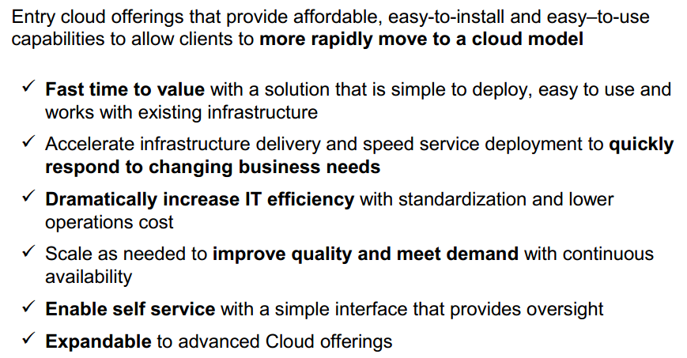
SmartCloud Entry的价值
May 17, 2012

Slide 16

Questions

